Slide 1
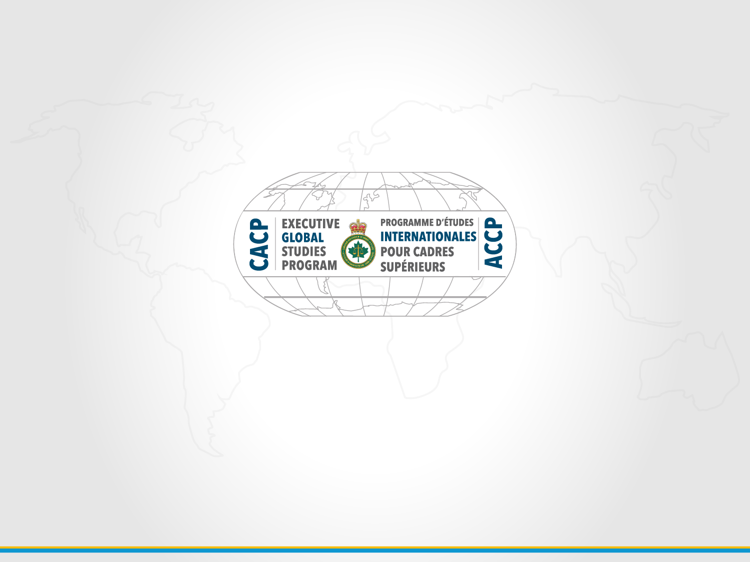
New Patterns in Public Trust and Confidence:
What happens there, matters here
CACP AGM August 16, 2016
Global 2016
Notes:
Norm to speak to this slide then introduce 2:00 minute video

Slide 2
How we respond to the forces of globalization and technological change will determine the durability of an international order that ensures security and prosperity for future generations.
President Barack Obama’s speech to Parliament
June 29, 2016
Notes:
Good morning and thank you for the opportunity for Global 2016 to speak to you today about the journey we have had this year. The three of us will be sharing the stage for our 89-slide PowerPoint presentation. I would say that this will be the most compelling presentation of the AGM but I would be overshadowing my own boss’ as well as my Deputy’s sessions on the agenda and will need to find alternative working arrangements after this is over.
A monkey bite in South Africa, evacuating Samoa before a hurricane shut the island down for 2 weeks, getting lost in Oslo - just some of the stories you won’t hear today, rather, what we want to share with you are our high-level research findings from Global 2016. Our goal is that in 25 minutes from now, you have a deeper understanding of the dimensions of globalization, are captivated by the 7 action items for Canadian police leaders, and consider for your own law enforcement agency the initial results of the follow-up survey of Canadian police leaders’ perspectives on the selected polarities. Lastly, we hope to generate enthusiasm and interest with extending this discussion today at the What Happens There Matters Here conference in September.
We believe that every police leader ought to participate in this discussion and just as President Obama noted in a recent speech to Parliament, “… we are at a pivotal moment for our nations and for the globe. How we respond to the forces of globalization and technological change will determine the durability of an international order that ensures security and prosperity for future generations.

Slide 3
Globalization is pushing Canadian police towards a series of tipping points:
Review of Police Act in Ontario by Minister Naqvi due to “declining public trust”
Carding issue in Toronto eroding police credibility across Canada
World-wide media coverage of “police bad apples”
Failure to hold officers accountable for bad behaviour enrages the community
Skepticism around police demands for higher budgets in an environment of declining crime rates
Increasing recognition that calls for service are not all related to crime
Local media full of gun violence
Violent crime in Canada concentrating in certain areas
Radicalization to violence a major concern
Social media causing different behaviours
New communication channels now exist
Notes:
We were assigned an interesting – and challenging – research task: The Board asked us to consider the impacts that globalization was having upon policing in Canada.
The 21 of us met online for the first time in and after three intense residential sessions, continuing online collaboration, and a series of field studies conducted in 14 countries around the world, the team concluded our work in June. Even with the research statement in place, it was clear that the topic was still too broad and complex– globalization has tentacles woven through virtually all elements of modern society, and demands a deeper level of understanding.
What we did know was that Canadian police agencies were and are at a critical juncture in time where a series of events are pushing us toward a tipping point. Key among these being: Opening the Police Act in Ontario, world-wide media coverage of events in other countries impacting policing in Canada, calls for service that are not related to crime but rather mental health, gun violence, radicalization as well as social media. The common denominator woven through all of these tipping points - Globalization.

Slide 4
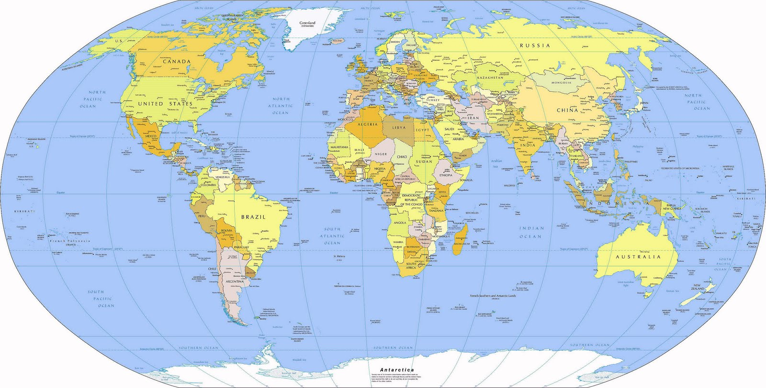
CACP Global 2016:
5 Teams
15 (13) Countries
5 Continents
Notes:
So, we split into 5 teams and collectively set out of visit 15 countries: Hong Kong, Singapore, Germany, Czech Republic, Netherlands, Austria, Norway, Sweden, Estonia, Rwanda, Tanzania, South Africa, Australia and Samoa.
These countries were chosen for a range of reasons: high levels of trust in Scandanavia, low levels in Africa, world leaders in the globalization index in Asia, Estonia, with the world’s most advanced public identity card system. Australia and Samoa - because of the unique approach Australia takes to preserving national security. And the western and eastern European countries collectively reflect unprecedented experience with both human migration and economic globalization.
As the teams were making their way to Rwanda and Tanzania, authorities cancelled the visas of the team members, and in parallel, Tanzania cancelled all scheduled meetings.

Slide 5
David Schneider, EPS:
13 Flights
64 hours in the same suit
Notes:
The most patient traveler award goes to David Schneider from the Edmonton Police Service who experienced 13 flights in 64 hours, all in the same suit.
Despite the setbacks, we grew our understanding of globalization through this international comparative study and have set out the necessary actions Canadian police leaders must take to ensure public safety, sustain confidence and build trust in policing for a changing Canadian society.
For more on this, I turn the mic over to Mike.

Slide 6
Multiple Polarities within Police & within Community
State Security
Human Security
Choices
Warriors
Guardian
Offender Focused
Victimization Focused
Tolerance to Violence
Intolerance to Violence
Openness
Closed
Notes:
Mike
Thank you Sharolyn - It was not until the sub-teams had returned to Canada and research findings were compiled that a series of ‘tipping points” began to emerge. Research teams observed police agencies taking very different approaches in their respective countries and we all then made an effort to explore these differences. Why, for example, was policing in Sweden was so different from policing in Hong Kong? How could a fundamentally similar public service like policing operate in such different fashions and achieve such different outcomes in different corners of the earth? It became clear that a series of choices had been made, deliberately or involuntarily, which in each case, served to move the policing agency in one direction or another along a sliding scale of possible behaviours, policy positions and operational practices, with diverse resulting outcomes. These choices and the corresponding variations in direction could not be viewed as necessarily being “better” or “worse” than each other. The decisions simply put each police agency on trajectories that led towards significantly different operating models, different outcomes, and most notably, differing consequences with regard to public trust and confidence.
Through the synthesis phase of the research, twenty different decision points, or polarities were discovered, evident to some varying degrees in every country studied. Global 2016 looks forward to further discussion of this framework of polarities with the CACP Research Foundation and other interested academic bodies.
The team believes further analysis may refine the underlying concepts, and further research may bring powerful insights into the changing relationships among Canadian citizens, communities, their police, and other state authorities. For initial application and further testing of these concepts, the full list was distilled down to the five most significant polarities, or those deemed by Global 2016 to be most accessible and currently relevant in Canada:
· State security vs. human security
· Warrior mindset vs. guardian mindset
· Prosecuting offenders vs. reducing victimization and supporting victims
· Tolerance to violence vs. intolerance to violence
· Open policing system vs. closed policing system
The polarities show considerable promise and may ultimately lead to an effective diagnostic tool for assessing any police organization’s tendencies and overall directions, and moreover, the alignment and impacts of its choices vis a vis the aspirations of the community they serve. The polarities alone do not point the way toward immediate action. However, the insights they generated led the group to an even more significant and practical set of observations and conclusions.

Slide 7
SURVEY
SONDAGE
Notes:
Francois
Merci Mike,
Good morning everyone.
I just want to let you know that my part of the presentation will be in both official languages, French and English.
A sample of over 100 Canadian police leaders were surveyed, with a view to gaining their perspectives, on a selected number of the èvident polarities, that Global 2016 Identified in its field studies and, subsequent syntheesis process. The following slides demonstrate the degree to which, globalIzation factors, might be affecting public trust and cônfidence in Canadian policing. Some Items reflect a cluster of agreement, around an average position. Most reflect a fairly wide distribution, tending towards the poles. But, each begs the questions: “Where do Canadians think we are?” and “Where do Canadians want us to be?”.
Let’s have a look at the 6 questions of the survey!

Slide 8

Question 1:
Where does your police agency’s model fit in terms of disclosure of information with the public?
www.cacpglobal.ca

Slide 9
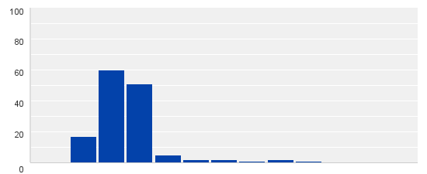
Canada
Average Police Leader Response
Norway
Germany
Hong Kong
South Africa
Open Policing
Neutral
Closed Policing
Distribution of Canadian Police Leader Responses
Notes:
GlobalIzation is about complexity and côntradiction.
Where would you put Canada? Where would you put your agency? Where would the community put your organIzation? What did you use to inform your choice?
There is no right or wrong place to be, rather there are consequences to being where you are. You both gained, and had to give something up, to be where you are. We subjectively placed some of the countries visited on the spectrum to gage a comparisson on where Canada’s perspective is in the eyes of Canadian police leaders.
Clic
As you can see on this slide, most police leaders that were surveyed were thinking that Canada is an open police system.
Let’s have a look at question number 2.

Slide 10
Question 2:
In your view, are citizens in your community becoming less or more tolerant to violence in Canadian society?
www.cacpglobal.ca

Slide 11
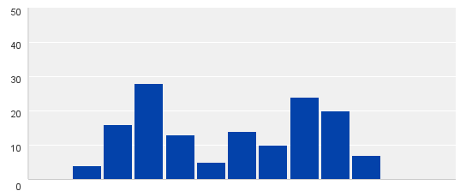
Canada
Average Police Leader Response
South Africa
USA
Sweden
Australia
More Tolerant to Violence
Less Tolerant to Violence
Neutral
Distribution of Canadian Police Leader Responses
Notes:
When I said that Globalization is about complexity and contradiction, this is what I meant.
Clic :
You can see now that Canada his slightly on the tolerance side. But this is not what we should pay attention to. Have a look to the distribution of Canadian police leaders’ responses; you will see that our vision is much diversified on that topic.
In my opinion, I don’t think that any of my family members were ever directly exposed to violence. However, in certain places on this planet, someone is asking exactly the same question but the other way around. Are there any of my family members that were NOT exposed to violence? This is a comment I heard when I was in South-Africa.
In that perspective, the normality cannot be defined the same way at all.
Let’s have a look at question number 3. THHre

Slide 12
Question 3:
Est-ce que vous diriez que votre service de police sers d’avantage les besoins du système judiciaire ou vise-t-il d’avantage à reduire la vicitimisation?
www.cacpglobal.ca
Notes:
English: Where do you see the priorities of your police service in regards to serving the needs of the system vs. reducing victimization?
French no 2: Est-ce que vous diriez que les efforts de votre service de police sont d’avantage utilisé dans le but de nourrir le système ou il vise d’avantage à réduire la victimisation?

Slide 13
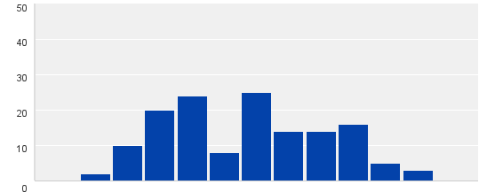
Canada
Average Police Leader Response
South Africa
Hong Kong
Germany
Sweden
Singapore
Norway
Focused on Prosecuting Offender
Neutral
Focused on Reducing Victimization
Distribution of Canadian Police Leader Responses
Notes:
À quel endroit pensez-vous que les résultats du sondage ont placé le Canada sur cette échelle? À quel endroit placeriez vous votre propre organisation?
Clic:
Encore une fois, nous pouvons constater que les leaders de nos organisations policières du pays sont partagés entre ces deux pôles.
Peut-être diriez-vous que l’équilibre entre ses deux extrême est l’endroit idéal pour une organisation policière de se trouver?
Ce que je pourrais vous répondre est ceci :
Dans le cadre du « Global studies 2016 », il va de soit que plusieurs observations ont capté l’attention de notre groupe de chercheurs. Parmi l’une d’elle, se trouve l’orientation que certaines organisations policières ont prise à ce qui à trait à tout le volet de la victimisation. Ces dernières ont déployé des efforts important en sécurité communautaire afin de voir une réduction réelle de la victimisation. D’ailleurs, notre équipe qui s’est rendue au Tribunal pénal International de La Haye aux Pays-Bas, fut grandement impressionnée par leur approche unique dans le domaine.
Le Canada a déjà fait un pas dans cette direction avec l’entrée en vigueur de la Charte Canadienne des droits des victimes.
Passons à la prochaine question.

Slide 14
Question 4:
À quelle mentalité rattacheriez vous votre service de police: à celui de Gardien de la paix ou à celui de Guerriers (chasseurs)?
www.cacpglobal.ca
Notes:
English: Where do you see your police service in its application of the so-called Guardian vs. Warrior mindset?

Slide 15
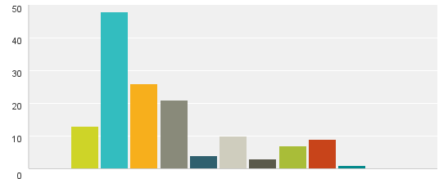
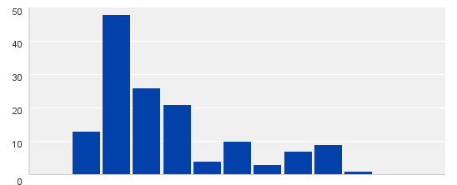
Canada
Average Police Leader Response
Sweden
Germany
Hong Kong
South Africa
Norway
Australia
USA
Protecting the Community
Neutral
Conquering the Enemy
Distribution of Canadian Police Leader Responses
Notes:
Est-ce que le sondage placera le Canada encore sur la ligne médiane?
Clic:
Nous pouvons constater qu’une large proportion de nos leaders sondés sentent que leur service de police répondent d’avantage aux besoins reliés à la protection de la communauté, qu’à celui de conquérir l’ennemi (le criminel).
Dans cette perspective, l’équipe du “global 2016” qui s’est rendue en Suède par exemple, ont vu que ces derniers avait une approche assez innovatrice lors de rassemblement public ou de manifestation. En effet, au sein même de la police Nationale suèdoise une équipe porte le nom de : “The Dialogue police” . Cette équipe est formée pour parler et dialoguer avec les gens et les manifestants. Cette approche vise à diminuer le risque d’escalade de tensions et d’éviter par le fait même l’emploie de la force par les autorités policières.
Est-ce que les services de police du Canada devraient d’avantage être perçu comme des bâtisseurs dans nos communautés?
Passons à la question 5.

Slide 16
Question 5:
Where do you see your police service in the degree to which it seeks to serve the needs of the state and/or the needs of the citizen?
www.cacpglobal.ca

Slide 17
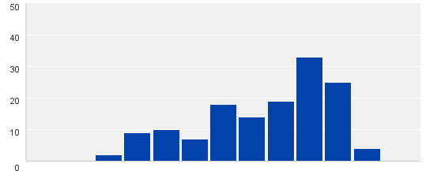
Canada
Average Police Leader Response
Hong Kong
Germany
Singapore
Australia
Norway
Serving the State
Serving the Citizens
Neutral
Distribution of Canadian Police Leader Responses
Notes:
This question is an extension of the last one. I think it should show the same result. Let’s see now where Canada stands.
Clic:
Most of Canadian police leaders thinks that there own organIzation is serving the needs of the Citizens. I think, that every one in this rooms believes the same thing? But, do you believe that the population that you are serving will think alike?
In Norway the population talk about there police department as the “Uncle police”. Why? They like there police services and they are ready to defend it.
Let’s have a look at the last question.
Passons à la dernière question

Slide 18
Question 6:
À quel degré diriez-vous que votre service de police intègre une évaluation de l’environnement internationnal dans ses processus de planification?
www.cacpglobal.ca
Notes:
English : To what degree is your agency incorporating global environmental scanning in its planning processes?

Slide 19
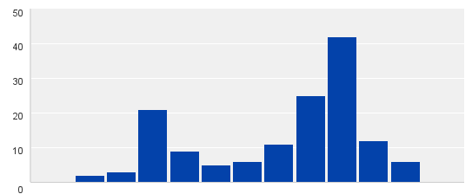
Canada
Average Police Leader Response
Germany
Hong Kong
Australia
Sweden
South Africa
USA
Singapore
No Global Perspectives Applied
Neutral
Well-Informed Global Perspectives Applied
Distribution of Canadian Police Leader Responses
Notes:
Plusieurs organisations font une évaluation (triénale ou quiquénale) sociodémographique de leur municipalité, mais est-ce que nous informons nos leaders sur une base régulière de ce qui se passe dans le monde? Pourtant cet élément pourrait avoir une incidence importante sur les décisions de vos officiers en lien avec certain événement.
Clic:
Nous pouvons voir une fois de plus qu’il y a un certain partage dans les réponses que nous avons recueillies sur l’échelle du Canada. Fort heureusement, nous nous retrouvons sur le côté des organisations informées. La vrai question que nous devons nous poser est la suivante: Le sommes-nous vraiment?
Un peu plus tôt, nous a parlé de l’approche unique de la police de Hong Kong sur la question. Cet élément devrait nous porter à réfléchir.
Je me tourne maintenant vers Mike pour la fin de la présentation.

Slide 20
If we are to adapt to the realities of a globalized world, here are the action imperatives we must undertake:
  Rebalance the criminal justice system from an offender to a victim and witness focus
  Take a global perspective when making evidence-based decisions
  Find new ways to engage with our communities on sensitive issues like balancing rights of privacy, prevention vs. enforcement, new sources of crime etc.
  Adopt consistent and comprehensive training standards and acknowledge the complexities of police education
  Insulate Canada from a growing culture of violence and other forms of crime (civil disobedience, reflections of a disturbed world)
  Exploit opportunities to leverage technology
  Recognize that the current approach to leadership must meet the demands of a globalized world
Notes:
If we are to adapt to the realities of a globalized world, here are the action imperatives Global 2016 believes we as policing leaders must undertake:
#1: Reform the judicial process so that the focus is on reducing victimization. As Dmytro Suprun from the International Criminal Court was quoted as saying to one of the Global 2016 members: “Bringing the voice of the victim to the court”.
#2: We found several countries set a high standard for developing a thorough global environmental scan which is incorporated into their local strategic plans. This commitment provides global perspectives of emerging issues and trends that may affect how the police service deploys resources and effective decision making. An example comes from the Hong Kong Police where I personally witnessed their utilization of Graduate Students in specific programs such as economics or political science assist police leaders with the collection and preparation through global research from their specialties. What we are asking for is a much broader scan than the current national/provincial threat assessments, organized crime reports, INSET reports and situational reports but rather world politics, economics, society demographics, science and technology, health and legal developments which will help educate the policing community about the world they live in.
#3: The Canadian Policing Community must take a more pro-active role in recognizing ourselves as a world leader in community building. We need to strengthen this competency further which will help to reinforce trust and confidence. We must continue to better connect with our communities on complex issues, such as: balancing rights of privacy, prevention vs. enforcement, and new sources of crime. Make our communities engagement part of our daily business.
#4: A number of countries visited benefit from one national policing agency that allows for a better level of coordination and interaction. Training length for police varies from 36 weeks to 3 years with different standards and outcomes. The more lengthy training was found to inculcate a positive/professional police culture, ethics and skills in conflict de-escalation. More time also allows for identification of candidates that are not suited for a policing career that can only be found with greater observation. For example in Norway, their 3 year program resulted in a publically perceived professional police officer that adds to the high level of public trust and confidence the police enjoy. In Australia, a “Shared Leadership” model states that no one executive has all the answers/information and encourages leaders to seek out needed information/opinions either up or down, internal or external. Hong Kong has mandatory leadership training requirements at two intervals in the first 10 years of each police officer’s career. Norway and Sweden provides enhanced learning opportunities to members to meet the need for higher analysis and research competences within policing. Austria has extensive continuous leadership training program including a 9 month middle management training and senior officer training– preparing for leading. The Canadian Policing Community should adopt consistent and comprehensive training standards and acknowledge the complexities of police education which is explained to our communities.
#5: This is a tough matter to accomplish and cannot be done by Canadian policing alone. In some of the countries Global 2016 visited, civil unrest and violence were observed as a normalized and effective tool for expression and change by community members. Migrant groups to those countries exhibited violent and criminal behavior, mirrored from their respective home countries which brought a new dynamic to the host nation policing. Canadian policing leaders must understand the impacts of cultural shifts within the Canadian mosaic and work within government, the community and immigrant populations to ensure the there is no degradation of our rule-based society.
#6: The Canadian Policing Community must better leverage existing technologies and adopting new ones to optimize: systems (connected), processes (accelerate - analysis and business intelligence), information (classification, access, storage), devices (communication, use of force, collection sensors), locations (virtual, CCTV) and human versus machine tasking. Many countries exploit technology to a much greater extent than Canada. Hong Kong just stood up their 600 personnel cybercrime division. Singapore has thousands of CCTV cameras adding to their community monitoring.
#7: Lastly and is well understood by this group, policing is becoming more complex and no single leader has all answers. Leaders need to develop an appetite for global research and evidence based studies. Leaders need to set positive examples and quickly, fairly and with transparency deal with unethical and corrupt behaviour.
These are 7 observed imperatives from our international comparative study: strategies to adapt Canadian policing to the complex contradictions of a globalized society.
I would now like to hand over to my colleague, Inspecteur-chef François Duguay de la police de Gatineau.

Slide 21
Success depends upon unity
Canadian Police Leaders must be unified in our knowledge of the world, ethics, approach to leadership, practices, training, priorities, and message.
Without unity, the negative impacts of Globalization will destroy trust and confidence
Notes:
Mike closes
We quickly came to the conclusion that the common denominator to our journey was and is unity. Unity is a fundamental enabler of police operations, a strategic advantage to policing effectiveness and can become a bedrock of our profession. We must become familiar with the frameworks to understand unity and its associated trust and develop a common language to discuss it effectively.
We challenge all police leaders, policy makers and researchers to join in the discussion on these imperatives and build this common understanding. We are seen throughout the world as being an example for other police to emulate yet there are still lessons we can learn and adapt to maintain this enviable reputation.

Slide 22

Notes:
We would like to end our presentation with an introduction to What Happens There Matters Here. “Policing and Community Safety in an Increasingly Globalized World”, scheduled for 25-27 September 2016 here in Ottawa.
The 7 Imperatives that has just been introduced today will form the framework for this two-day conference. Using a modified ‘world café’ model, each of these imperatives will in succession be informed by expert domestic and international speakers and resources representing police, policy makers and academics. In a highly interactive model, selected delegate panels will interact with the experts on each topic to assist the full delegation in the interpretation of these often complex and contradictory themes. Each segment of the conference will build on the others, with a view to determining together new courses of action for policing, national security, and community safety and well-being in Canada.
We believe there is a place for every CACP committee for this conference and call on the Chairs to send 1-2 delegates each as we believe this issue has only been scratched and a more fulsome deep dive is required.
Globalization is here to stay and those that refuse to adapt will be left behind.

